Slide 1
Method of Hyperparameter Optimization of a Genetic Algorithm applied in Critical Scenario Generation for Autonomous Vehicles
Master’s Thesis Presentation
Daniel Sumann

Slide 2
Introduction
Testing the functionality of autonomous driving systems is crucial to ensure road safety
achieving statistical safety necessitates a significant amount of ?Testing?
Method for critical traffic scenario generation using a genetic algorithm
Optimizes the cumulated emergency brake duration of the EGO vehicle by controlling all NPCs in the simulation
Research Question 1
Is a genetic algorithm suitable for generating critical driving scenarios compared to random search?
Research Question 2
Can the performance of a genetic algorithm be improved by optimizing the control parameter using the Taguchi method?

Slide 3
Simulation Setup – TODO: add bt to graphics or rm BT – test on wednesday
Traffic Manger provides a traffic simulation
vehicles drive in then simulation in a realistic manner
Provides an interface to alter vehicles behaviour through actions such as LaneChange, JunctionSelection, ModifyTargetVelocity, CrossRoad, etc …
Genetic Algorithm optimizes the cost function by directing NPC vehicles through specified actions.
Behaviour Tree is used on the EGO vehicle to generate more interesting scenarios
Sets different junction selections and avoiding blocking obstacles through lane changes
Traffic Manger
Cost
Genetic Algorithm
Action Interface
NPC 1
NPC 2
…

Slide 4
Genetic Algorithm Overview
Robust Search Algorithm:
Can navigate search spaces with lots of local optima
Population-Based Optimization:
Operates on a population of potential solutions.
Mimics the principles of evolution to find optimal solutions.
Utilizes genetic operators like crossover and mutation for reproduction.
Iterative Improvement:
Solutions evolve over multiple generations.
Fitness function guides the selection of better solutions, leading to convergence.
Gene and Chromosome:
Each chromosome and its genes form a solution to the search problem
Custom encodings for Genes and Chromosomes are required to describe a search solution
Two different encodings were designed to fit the given problem

Slide 5
Hyperparameter Tuning
Literature review
8 different hyperparameter combinations gathered from existing literature were tested over 5 repetitions
Taguchi Method
Part of Design of Experiment
Systematic approach for process optimization.
Identifies factors impacting performance.
Identifies optimal level combination
Developed by Genichi Taguchi for robust optimization.
Key Taguchi Concepts:
Orthogonal Arrays, Signal-to-Noise Ratio, Control & Noise Factors.
Advantages of Taguchi Method:
Robustness, Cost-Efficiency, Simplicity.
Required only 16 runs (each repeated 8 times) to optimize three 4-level and four 2-level factors as well as one interaction

Slide 6
Evaluation
Comparison between:
Optimized Genetic Algorithm – uses the resulting values from the Taguchi method
Default Genetic Algorithm – uses best values from the literature review
Random Search
Each algorithm was tested on
4 different start scenarios
10 repetitions per start scenario
2976 simulations per repetition
Goals
Test if genetic algorithms can perform better than random (research question 1)
Test if Optimized is better than Default (research question 2)

Slide 7
Genetic Algorithm Settings Comparison
Hyperparameter combination
Settings | Default | Optimized
Number of Generations | 30 | 30
PopulationSize | 96 | 96
CrossoverType | Two Point | Uniform 0.5
CrossoverRate | 0.8 | 0.9
MutationRate | 0.2 | 0.3
TournamentSize | 4 | 4

Slide 8
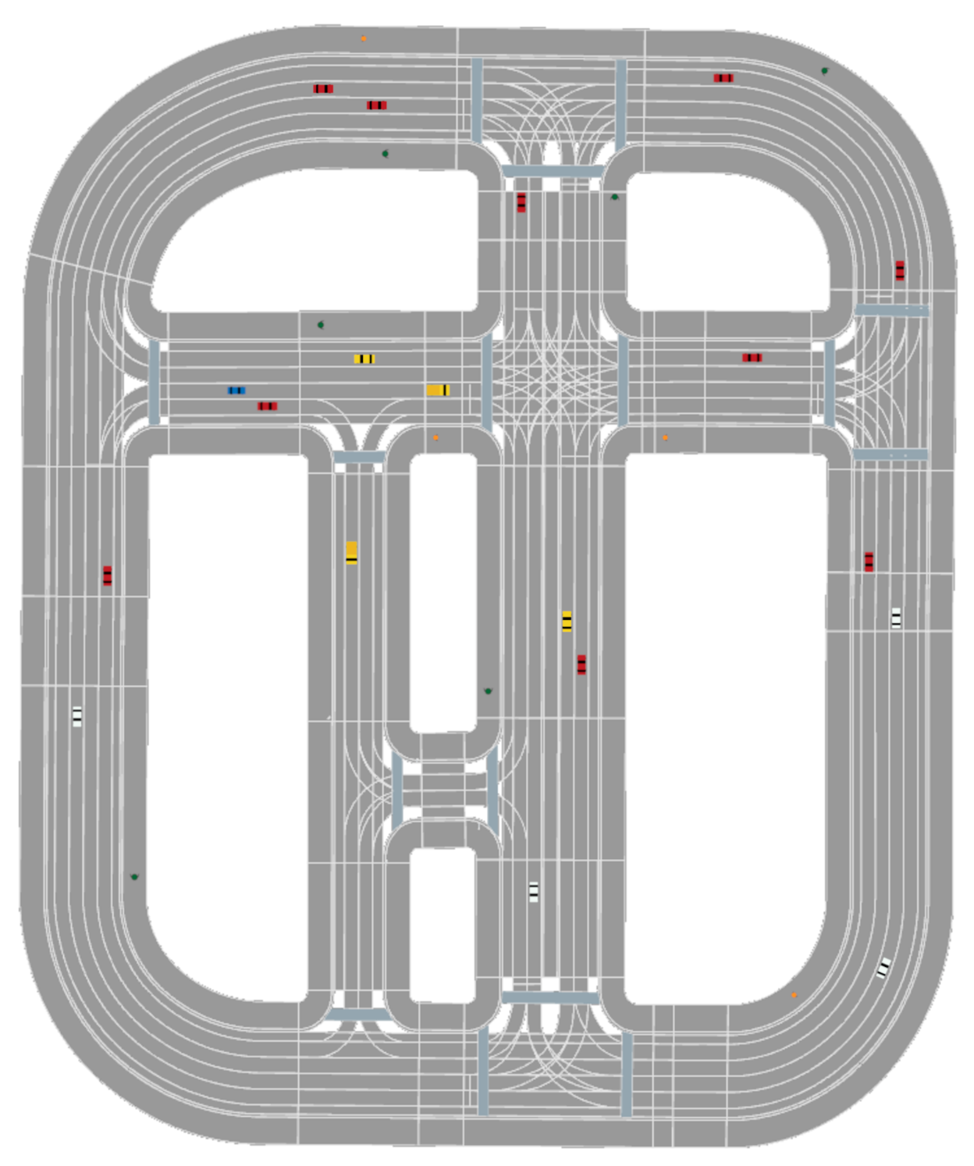
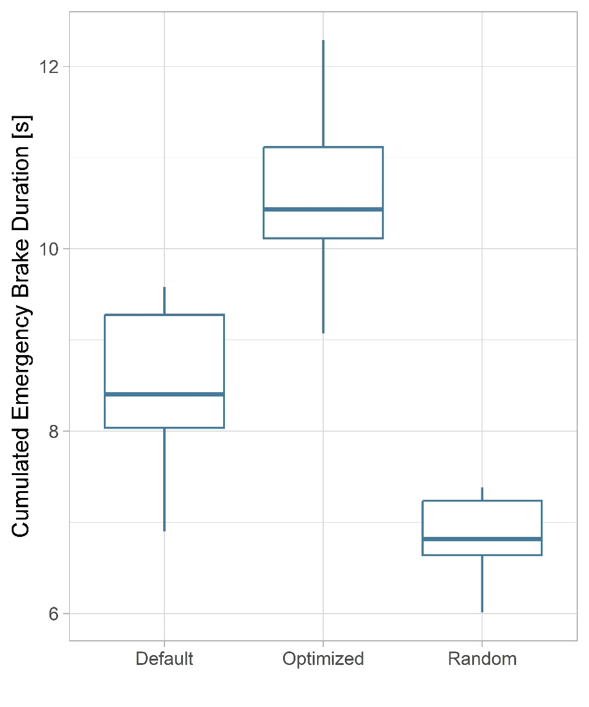
Evaluation: Start Scenario 4

Slide 9
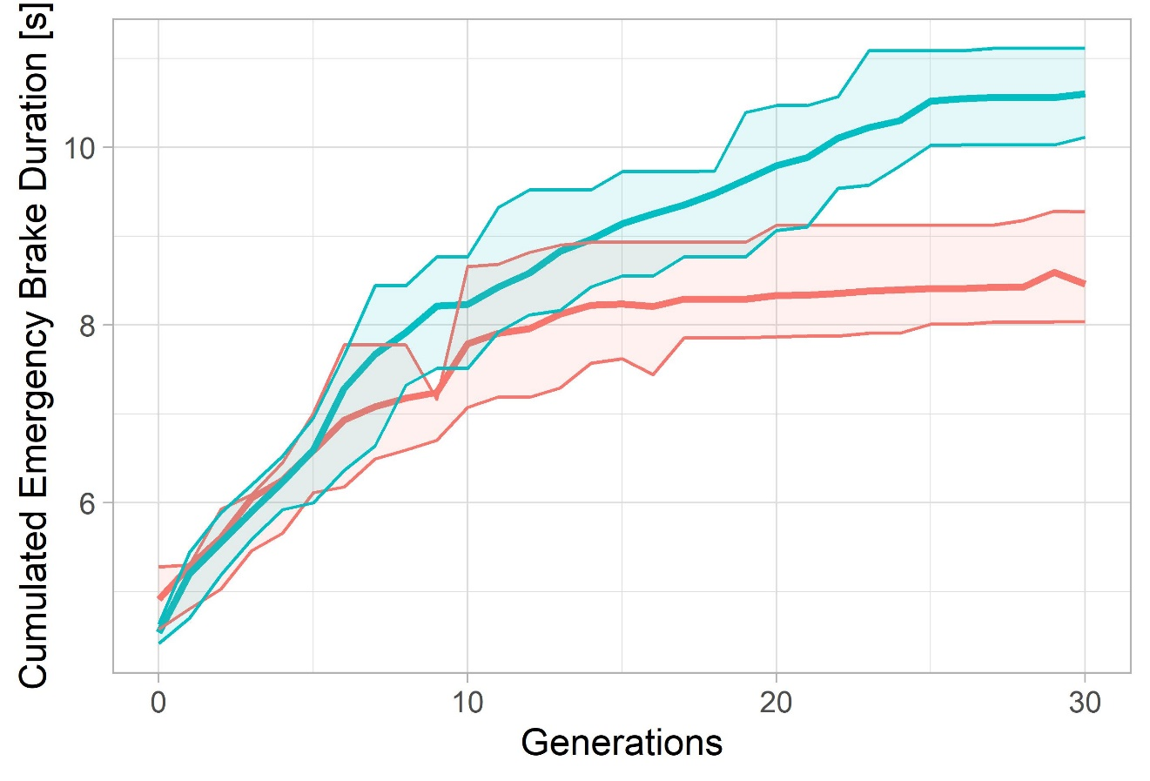
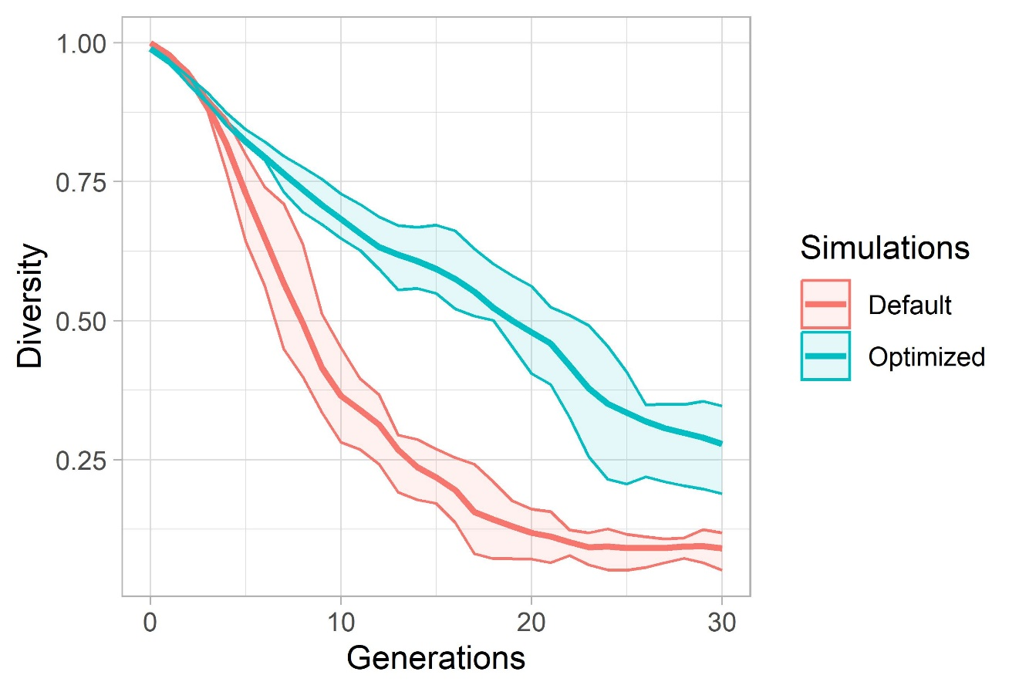
Evaluation: Start Scenario 4

Slide 10
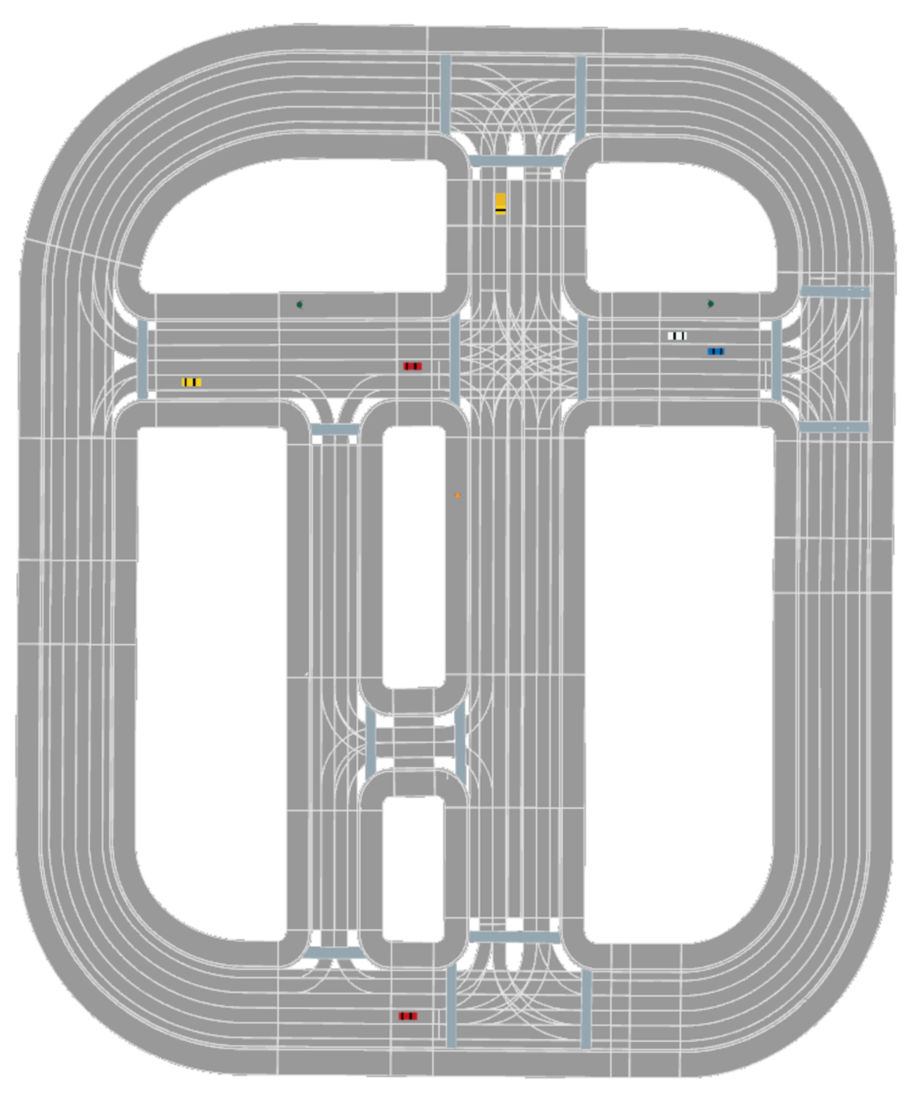
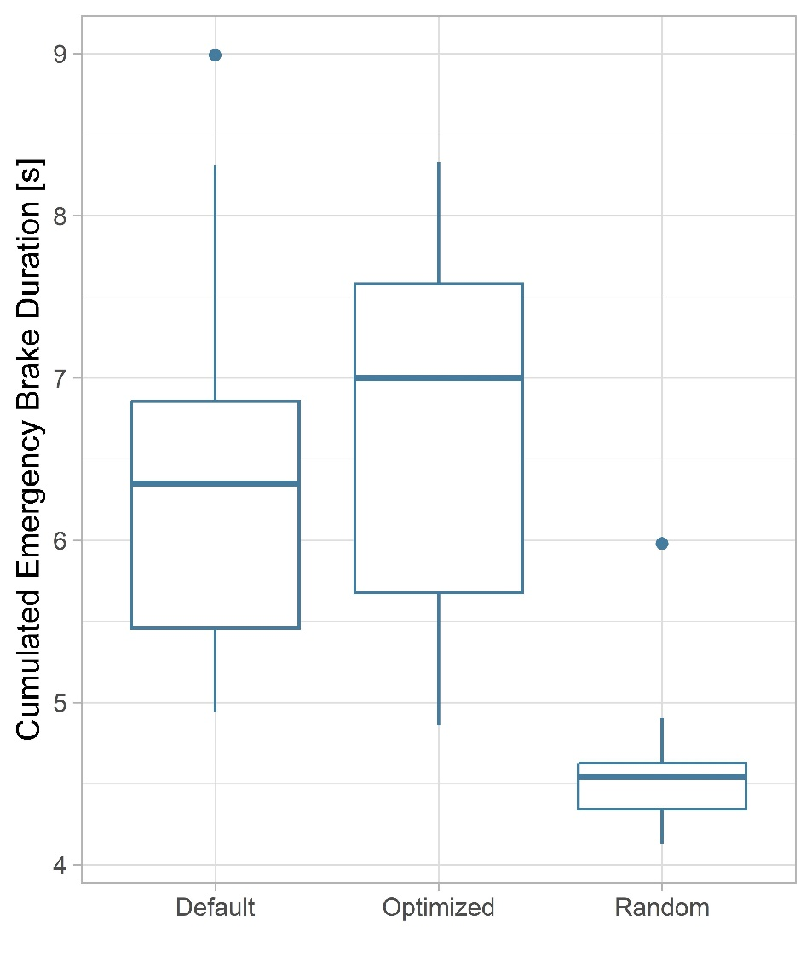
Evaluation: Start Scenario 3

Slide 11
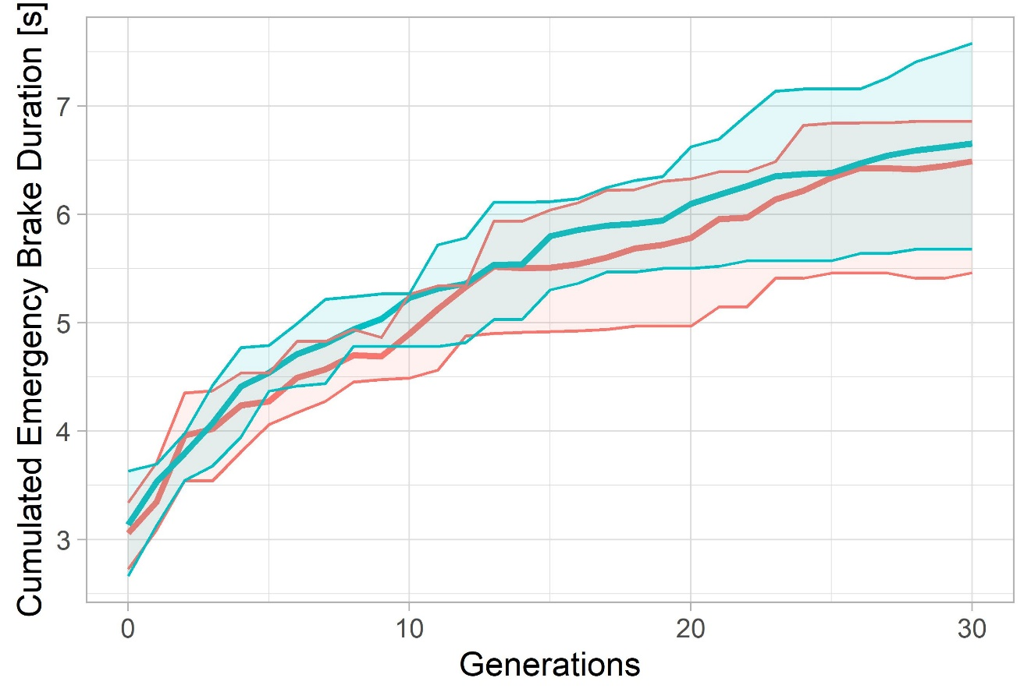
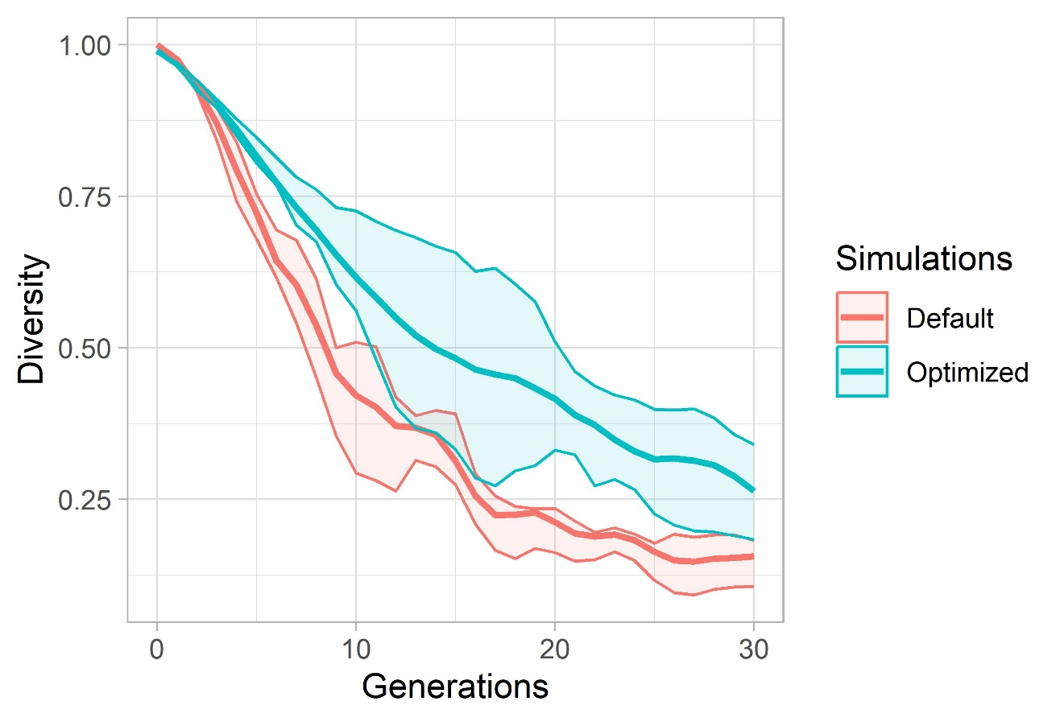
Evaluation: Start Scenario 3

Slide 12
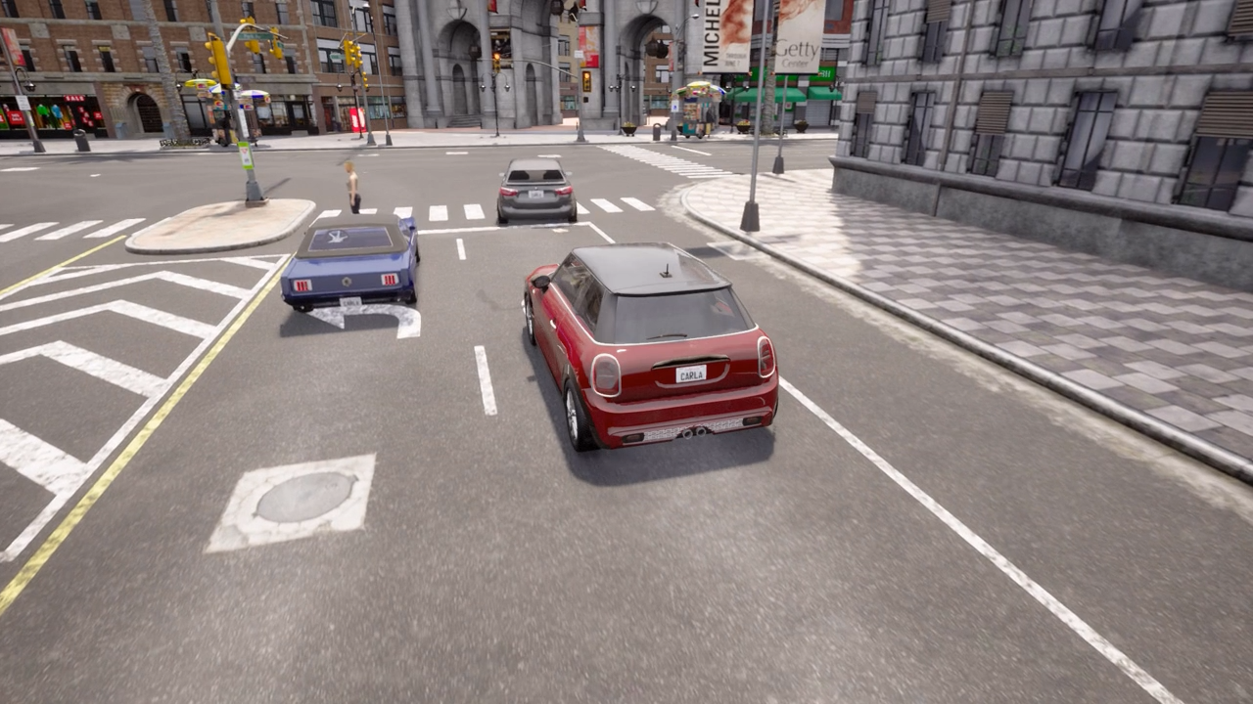
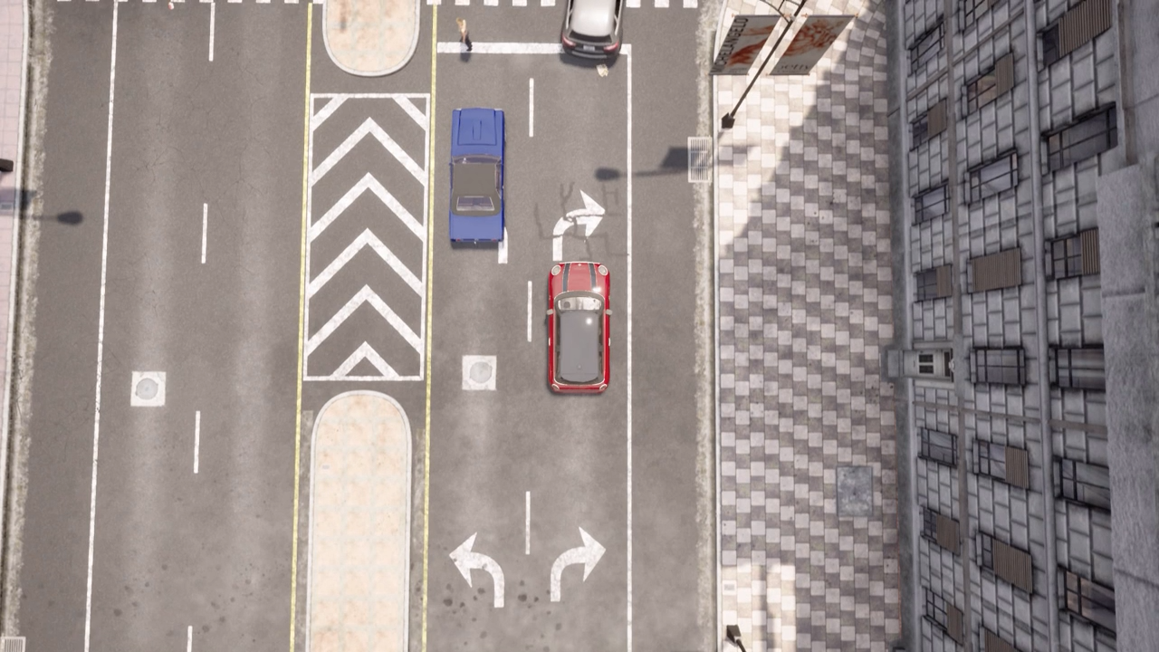
Critical Situation 1 – Scenario 1 - Carla
After pedestrian crossing
NPC vehicle cuts shortly before junction and violates path of EGO vehicle (blue)
EGO vehicle must perform an emergency break

Slide 13


Example videos – rendered in Carla
Inside junction
NPC vehicle ignores right of way
EGO vehicle (blue) must perform emergency break to avoid crash

Slide 14


Example videos – rendered in Carla
Kid runs over road
Kid is occluded by Truck
EGO vehicle (blue) has to emergency break

Slide 16
Gene Encoding
Encode as Integer
0 = NoAction
1 = JunctionSelection(straight)
2 = JunctionSelection(left)
3 = JunctionSelection(right)
4 = LaneChange(left, 3)
5 = LaneChange(right, 3)
6 = AbortLaneChange()
7 …
Encode as dictionary
{"type": "LaneChange", "direction": "left", "duration": 3}
{"type": "JunctionSelection", "junction_selection_angle": "straight"}
{"type": “AbortLaneChange"}
{"type": “ModifyTargetVelocity“, “percentage“: “133.4”}

Slide 17
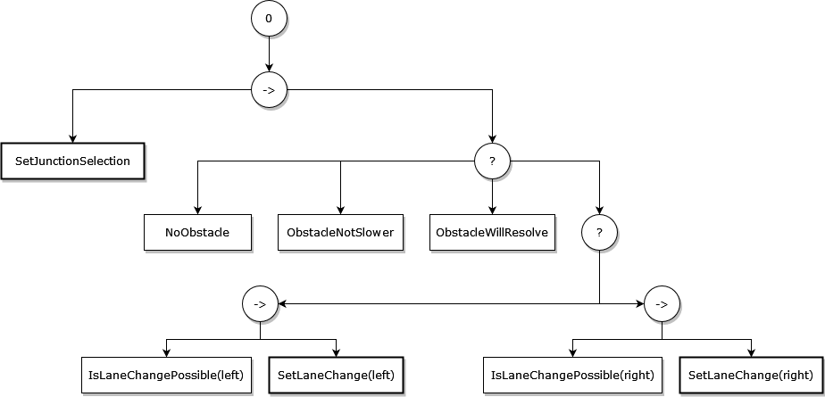
Behavior Tree

Slide 18
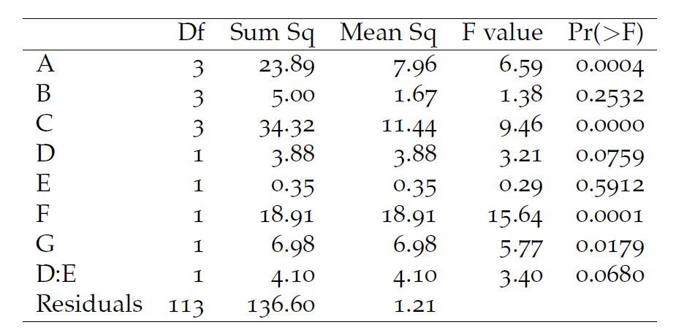
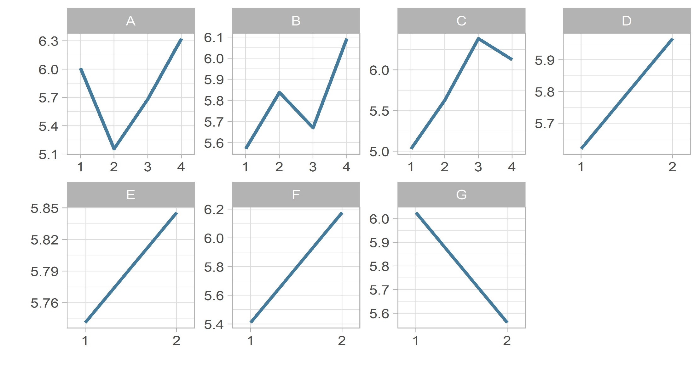
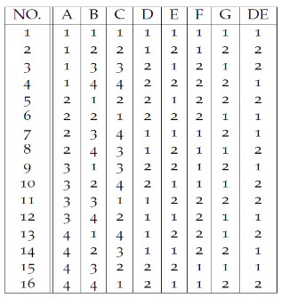
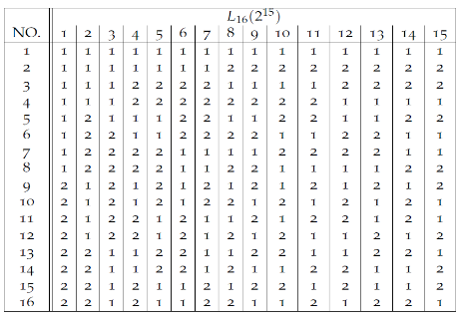
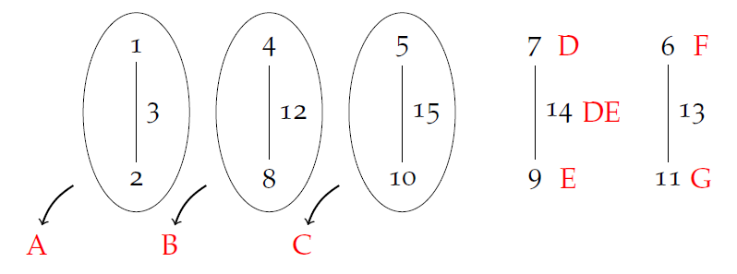
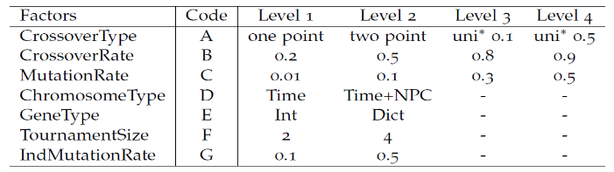
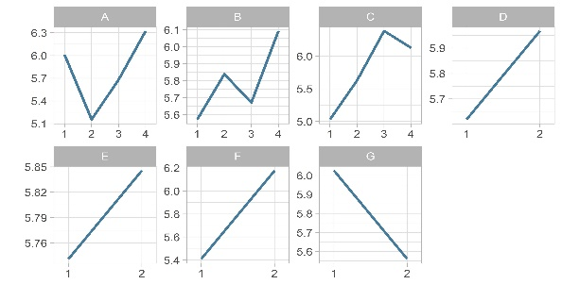
Taguchi Method – Step by Step
Factor and Level Selection
L₁₆ orthogonal array
Linear Graph
Run experiment using modified L₁₆ array
ANOVA
Main and Interaction Effects

Slide 19
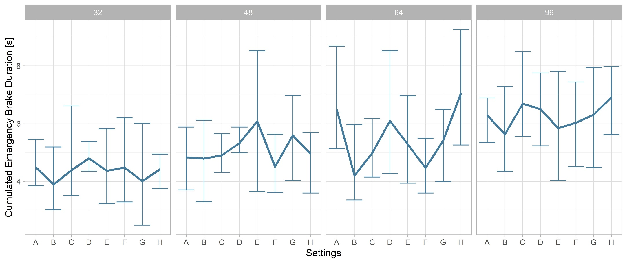

Slide 20
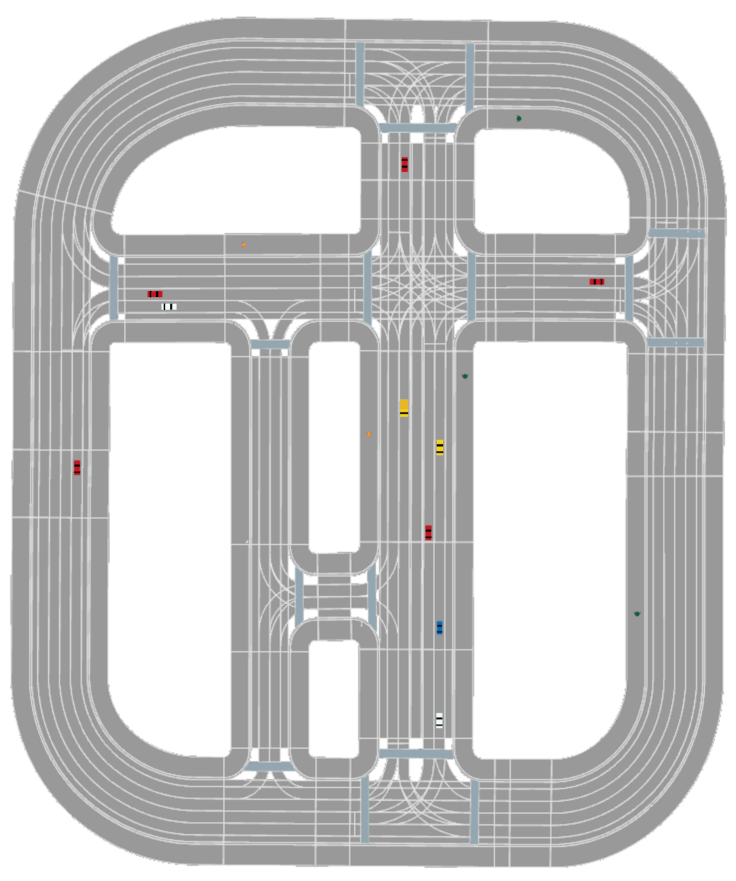
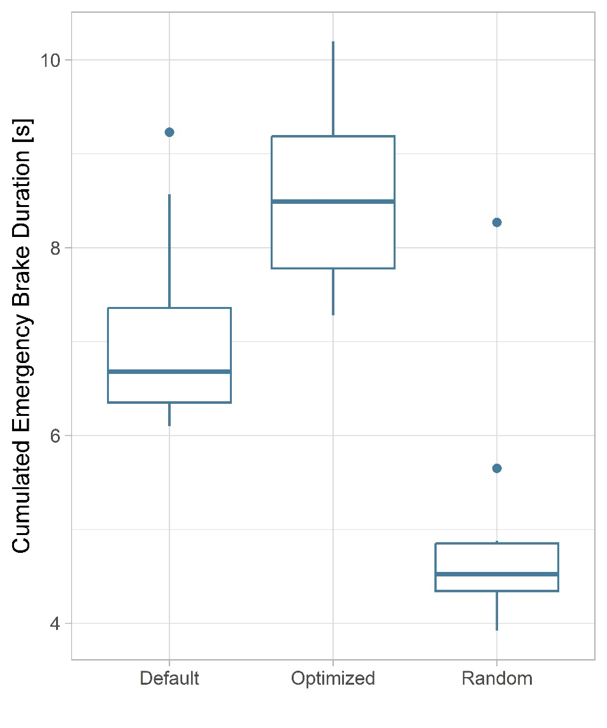
Evaluation: Start Scenario 1

Slide 21
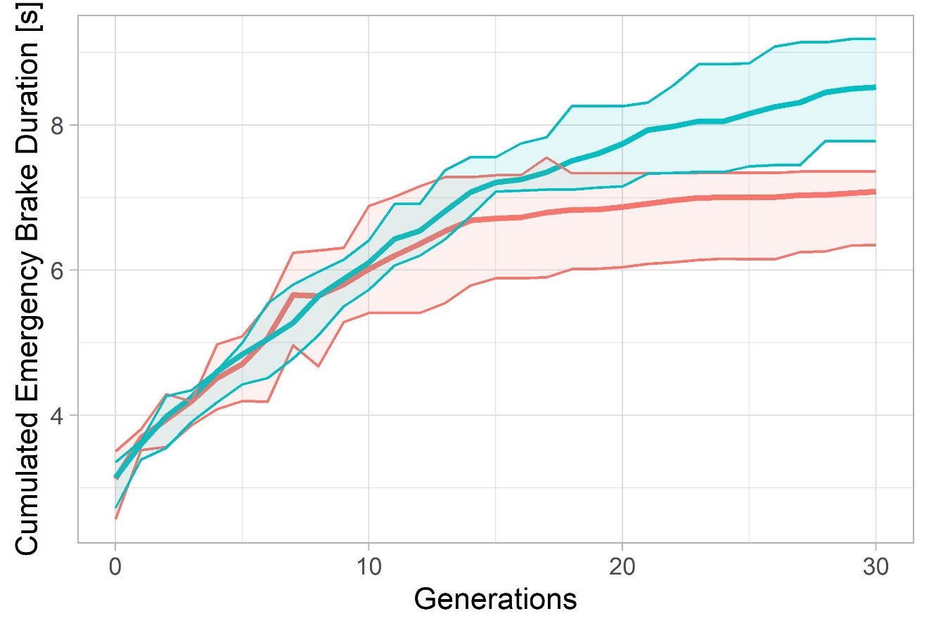
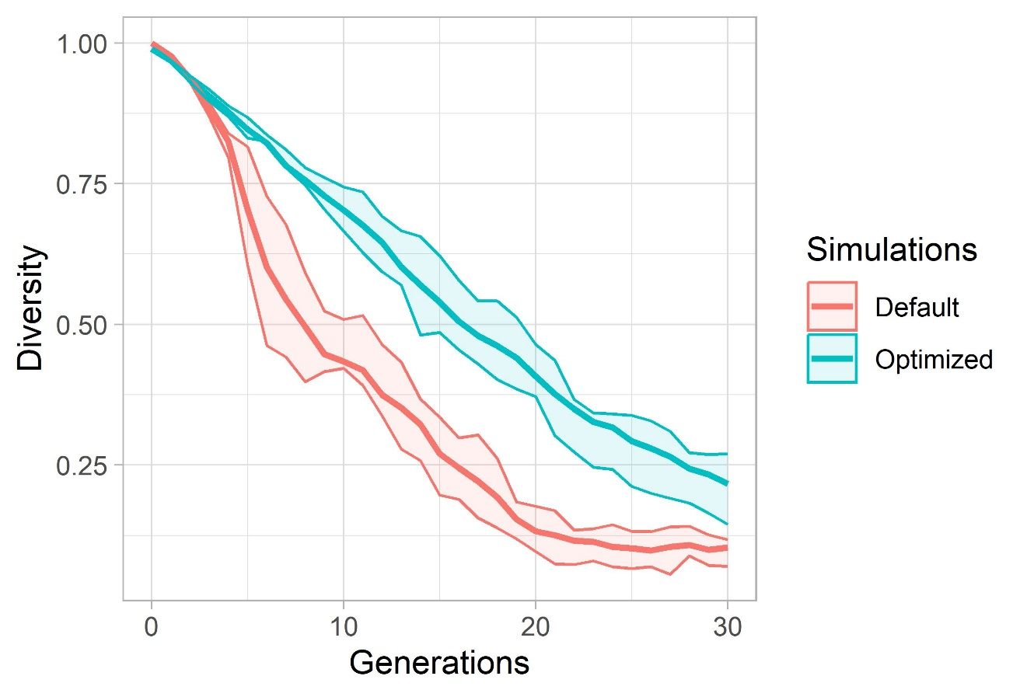
Evaluation: Start Scenario 1

Slide 22
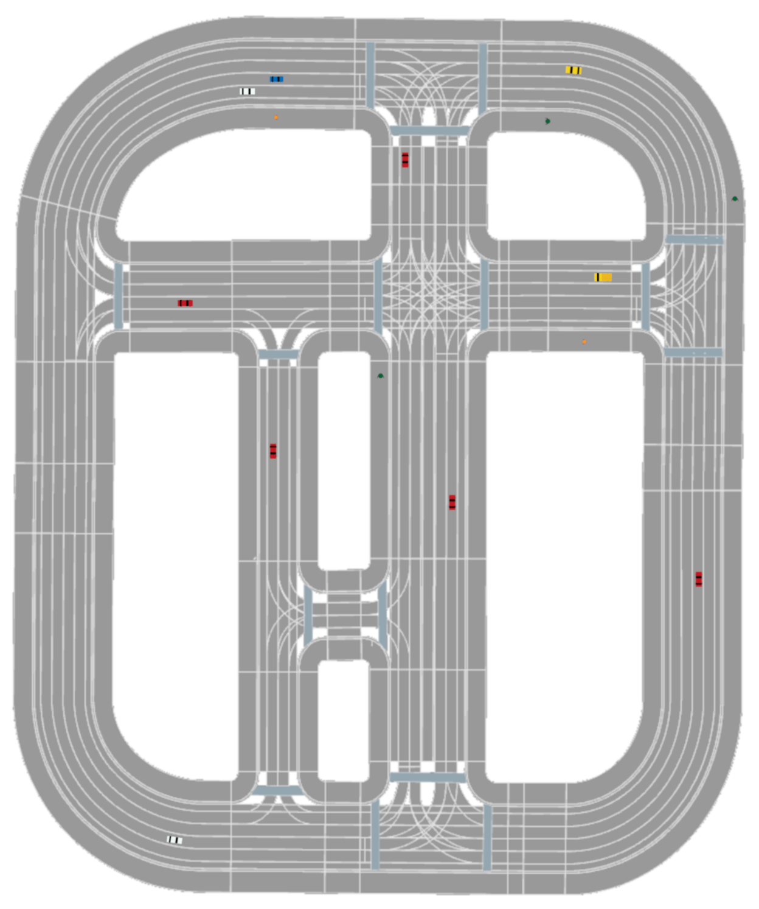
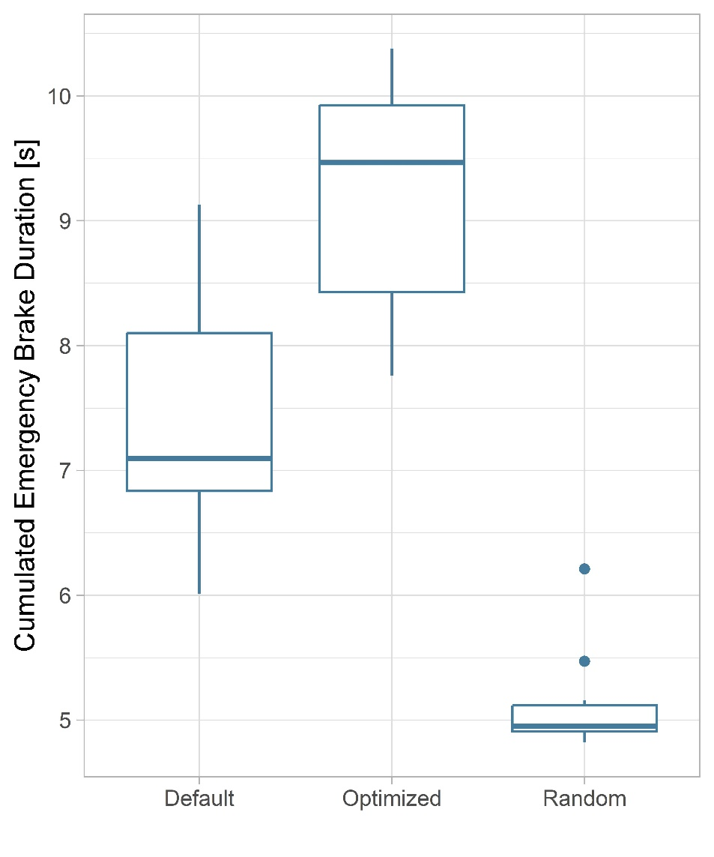
Evaluation: Start Scenario 2

Slide 23
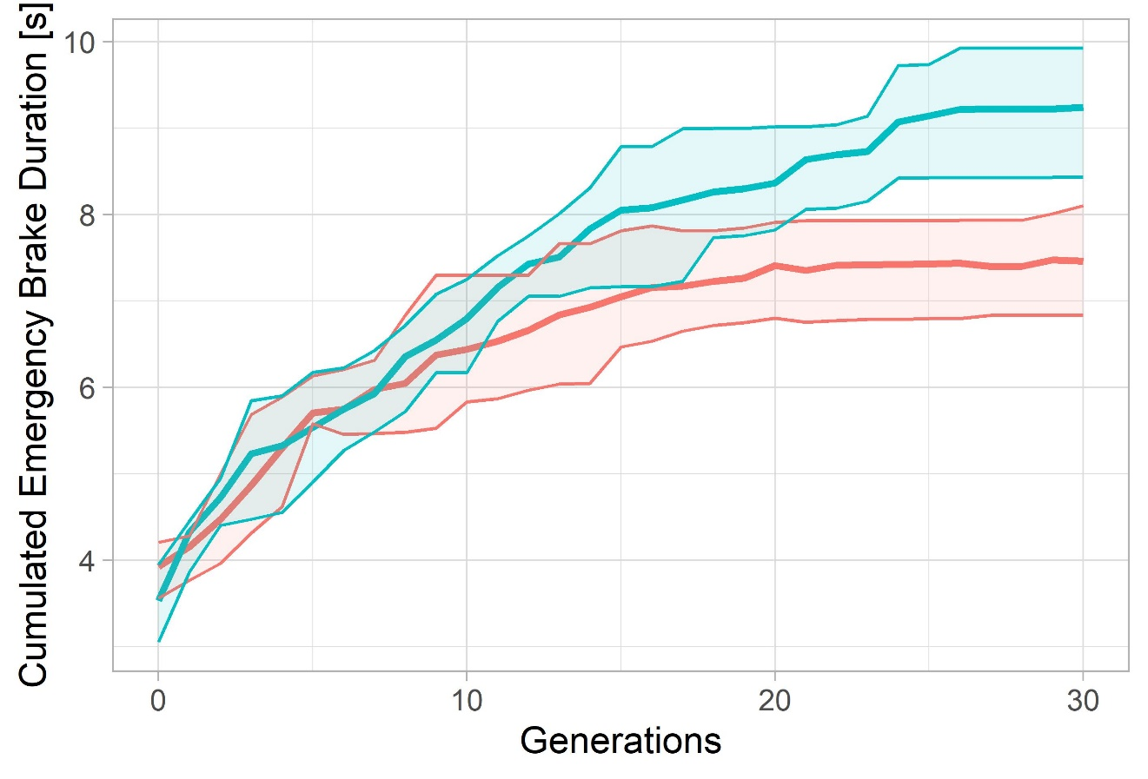
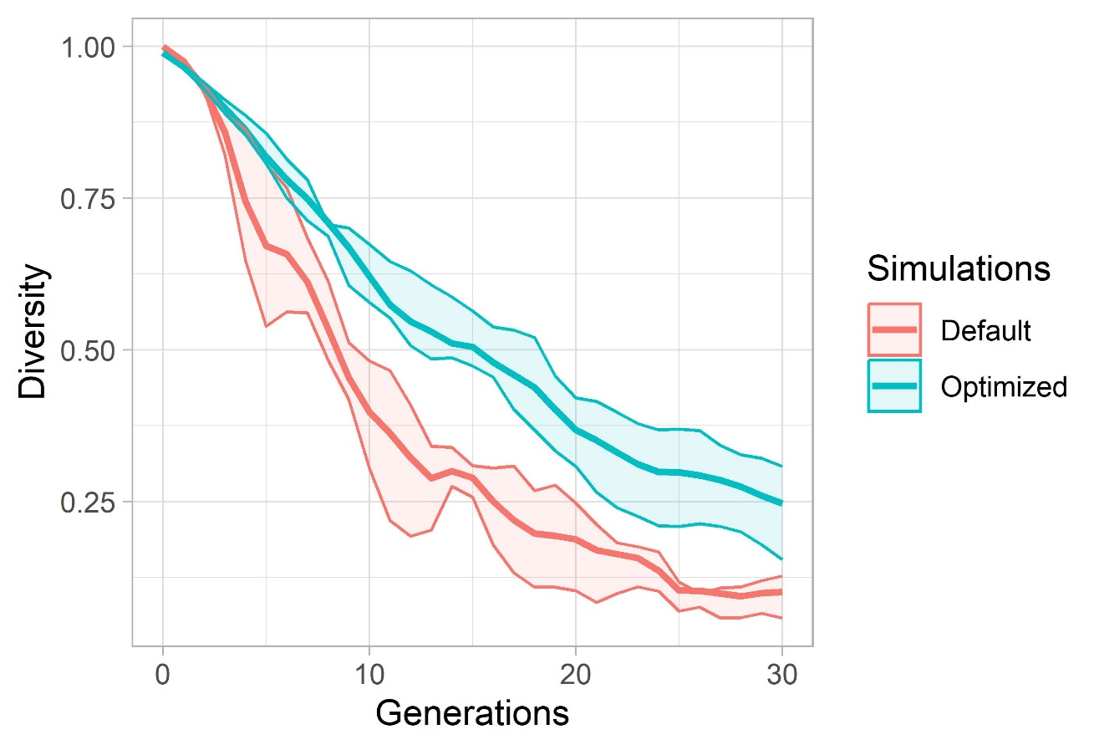
Evaluation: Start Scenario 2

Slide 24
Chromosome encodings
Time Encoding
0
1
2
3
4
5
6
7
8
9
10
11
12
13
14
15
16
17
18
19
Corresponds to timestep 1 (0.5 seconds)
Action NPC 1
Action NPC 2
…
Action NPC n
Time+NPC Encoding
NPC 1
NPC 2
NPC 3
0
1
2
3
4
5
6
7
8
9
0
1
2
3
4
5
6
7
8
9
0
1
2
3
4
5
6
7
8
9
Corresponds to timestep 1 (0.5 seconds)
Action NPC 1

Slide 25
Time Encoding – One Point Crossover
0
1
2
3
4
5
6
7
8
9
10
11
12
13
14
15
16
17
18
19
0
1
2
3
4
5
6
7
8
9
10
11
12
13
14
15
16
17
18
19

Slide 26
Time+NPC Encoding - One Point Crossover
0
1
2
3
4
5
6
7
8
9
0
1
2
3
4
5
6
7
8
9
0
1
2
3
4
5
6
7
8
9
0
1
2
3
4
5
6
7
8
9
0
1
2
3
4
5
6
7
8
9
0
1
2
3
4
5
6
7
8
9

Slide 27
ADD: pop size results
Add: all actions

